Slide 1
USE CASE
By: Keith Jacobson

Slide 2


GRADE SYSTEM
RECORD GRADE
VIEW
GRADES
PARENTS / STUDENT
TEACHER
CREATE REPORT CARD

Slide 3
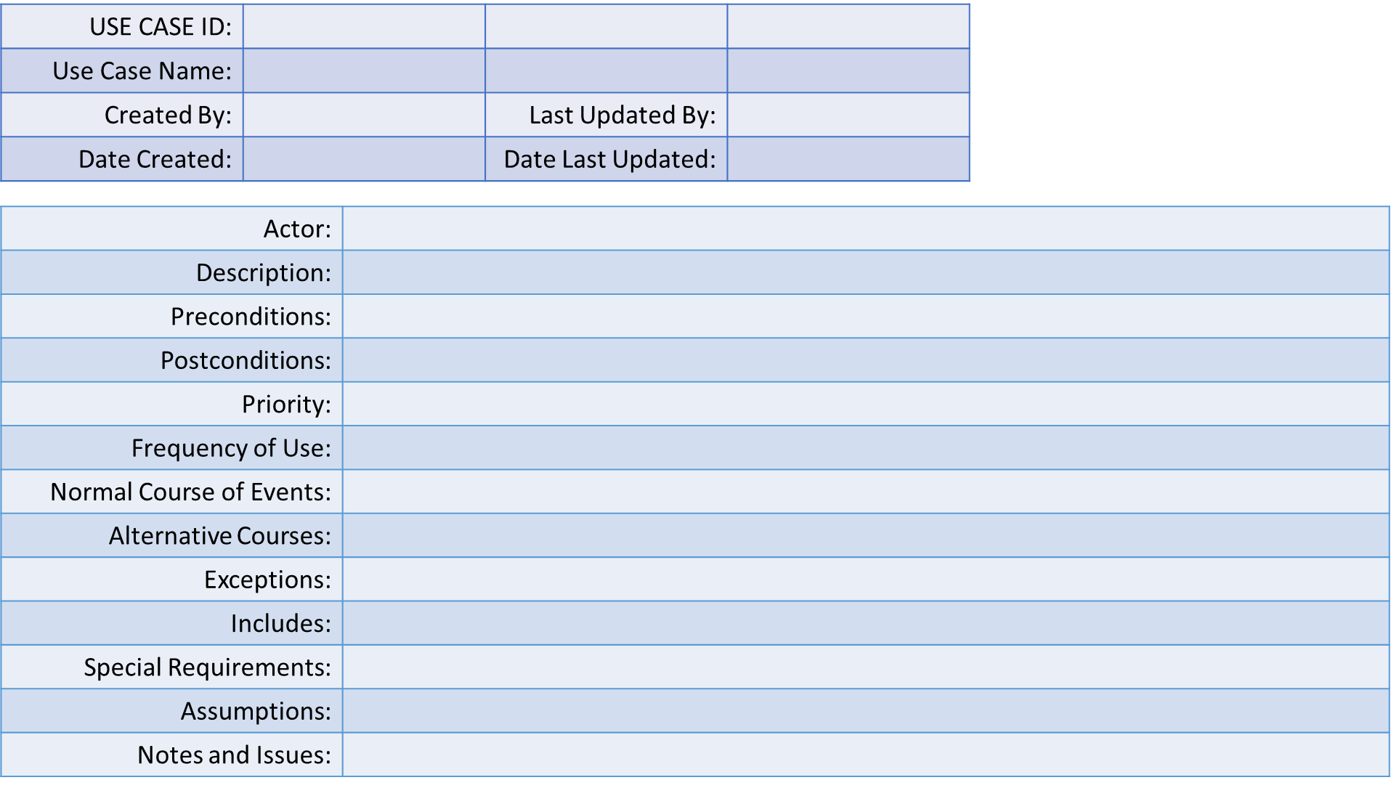

Slide 4
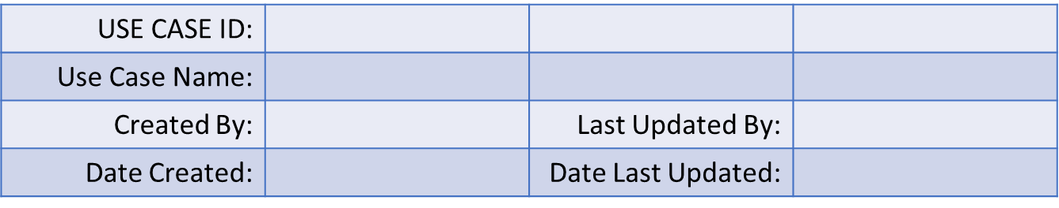
1. Use Case Identification

Slide 5
1.1 Use Case ID
Give each use case an unique identifying number for your records and easy access
Functional requirements can be linked and sources back to this ID.

Slide 6
1.2 Use Case Name
State a concise and result oriented name for your case.
Typically you will use a verb and a noun to describe what you want.
Be descriptive, no need to create something people won’t understand.
A few examples:
-GRADE SYSTEM
-VIEW PART NUMBER
-VIEW RECENTLY PURCHASED MERCHANTICE

Slide 7
1.3 Use Case History
1.3.1 Created By
1.3.2 Date Created
1.3.3 Last Updated By
1.3.4 Date Last Updated

Slide 8
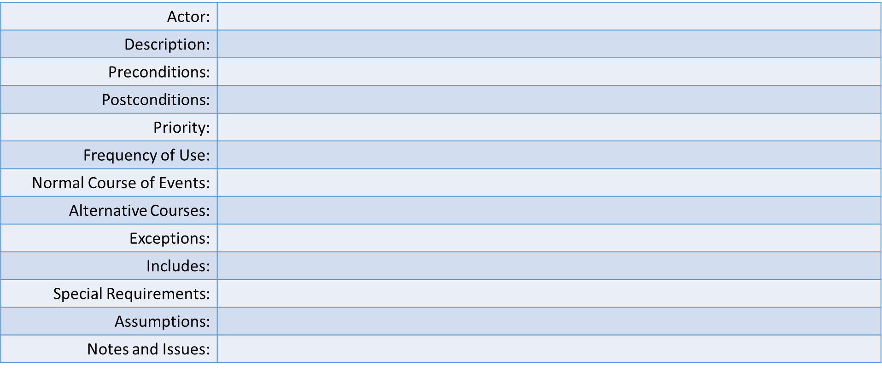
2. Use Case Definition

Slide 9
2.1 Actor
An actor is a person or external entity that will act on the use case.
Who will be “performing” this use case.

Slide 10
2.2 Description
Write a brief description of what the out come of the use case will be.
Or else write a detailed account of the order/sequence of actions will be taken place.

Slide 11
2.3 Preconditions
Identify any conditions that must be TRUE before the use case can move forward.
For Example:
-User has created an account.
-There is sufficient memory to run application.

Slide 12
2.4 Postconditions
What is the state of the system at the end of the use case. Name all that apply.
Example:
-Document is recorded in Access database.
-The software receives an update.

Slide 13
2.5 Priority
Indicate what priorities, or rather, what allocation of system resources need to be used to run the use case. This is also known as software requirements.
Example:
-8GB RAM
-4.3 GB HDD
-1.2GHz Processor

Slide 14
2.6 Frequency of Use
How often will the actors will use this use case in a given amount of time.
Example:
-50 x /week
-12 times / 24 hours

Slide 15
2.7 Normal Course of Events
Provide a detailed account or steps of what it takes to meet the description of the use case.
In other words answer the hypothetical question: “How do I accomplish the task as stated in the use case name?”
You can do this with numbered steps the actor will take and then the response the system will return.

Slide 16
2.8 Alternative Courses
Are there any other courses of action that can be taken that are different from the steps you provided in the normal course of events?
If so rearrange the numbered steps.

Slide 17
2.9 Exceptions
Describe any anticipated error messages that you could run into and find a way to have the system address them.
Example:
-”User name invalid” <Prompt user to try new name/register/contact helpdesk>

Slide 18
2.10 Includes
List all other use cases that are used by this use case. Common functionality that will or can be used in other use cases are the most common cases.

Slide 19
2.11 Special Requirements
Name any other requirements that might need to be addressed during the developing and design of the use case.
Example:
-Performance requirements
-Other quality attributes

Slide 20
2.12 Assumptions
List any assumptions that were made in the analysis that led to accepting this use case into the product description and writing the use case description.

Slide 21
2.13 Notes and Issues
List any additional notes or comments about this use case.
Or any TBD (To Be Determined) issues that have cropped up and list who will resolve them and by what due date.

Slide 22
USE CASE ID: | X1Y2Z3
Use Case Name: | Recording Grades
Created By: | Keith Jacobson | Last Updated By: | N/A
Date Created: | 9/01/17 | Date Last Updated: | N/A
Actor: | Teacher, Parents, Student
Description: | This describes the interaction that the teachers, parents, and students will have to assign, view, and report grades.
Preconditions: | The teacher, parents, or student will need to have an account they created to sign into the system and assign the grades.
Postconditions: | The grades will be saved in a centralized database where it can be retrieved by the website and teacher can add another grade.
Priority: | Minimum requirements. Chrome Browser Version 63.0.3239.132
Frequency of Use: | 18-24 times / week
Normal Course of Events: | Teacher clicks on record grade and enters the student name and the grade in format of <0/10> and the system will add grade totals and calculate final grade and percent. System accepts and allows to be viewed in user friendly webpage. System saves in centralized database to retrieve and print in report card format.
Alternative Courses: | Parents/ Students log in and click on view grade. Grade is pulled up and they can then view the students grades and notes made by teacher.
Exceptions: | If incorrect grade format is given then system will request proper grade be added.
Includes: | N/A
Special Requirements: | N/A
Assumptions: | None
Notes and Issues: | This use case is simple, but also incredible.

Slide 23
Actor: | Teacher, Parents, Student
Description: | This describes the interaction that the teachers, parents, and students will have to assign, view, and report grades.
Preconditions: | The teacher, parents, or student will need to have an account they created to sign into the system and assign the grades.
Postconditions: | The grades will be saved in a centralized database where it can be retrieved by the website and teacher can add another grade.
Priority: | Minimum requirements. Chrome Browser Version 63.0.3239.132
Frequency of Use: | 18-24 times / week
Normal Course of Events: | Teacher clicks on record grade and enters the student name and the grade in format of <0/10> and the system will add grade totals and calculate final grade and percent. System accepts and allows to be viewed in user friendly webpage. System saves in centralized database to retrieve and print in report card format.
Alternative Courses: | Parents/ Students log in and click on view grade. Grade is pulled up and they can then view the students grades and notes made by teacher.
Exceptions: | If incorrect grade format is given then system will request proper grade be added.
Includes: | N/A
Special Requirements: | N/A
Assumptions: | None
Notes and Issues: | This use case is simple, but also incredible.

